Slide 1
Table of Content
01
Data Description & Understanding
02
Exploratory Data Analysis (EDA)
03
Data Preprocessing
04
Machine Learning Modelling

Slide 2
DATA DESCRIPTION & UNDERSTANDING

Slide 3
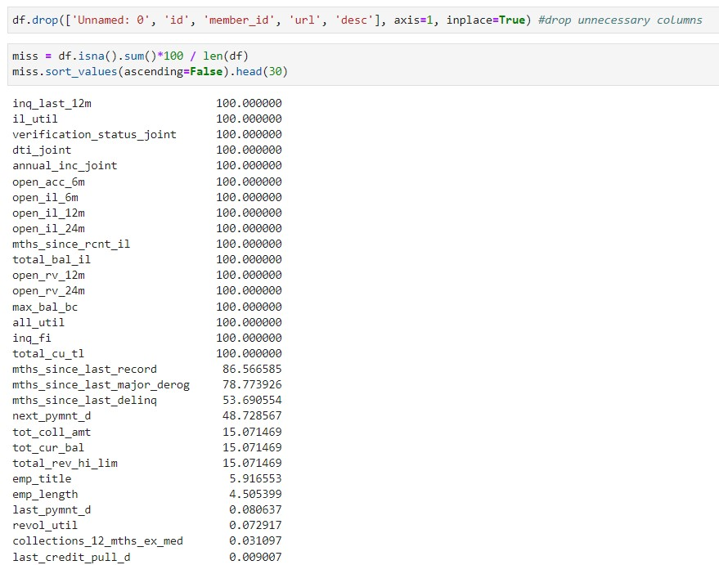
Data Understanding
Drop the unnecessary colums and drop columns that have
more than 30% NaN values

Slide 4
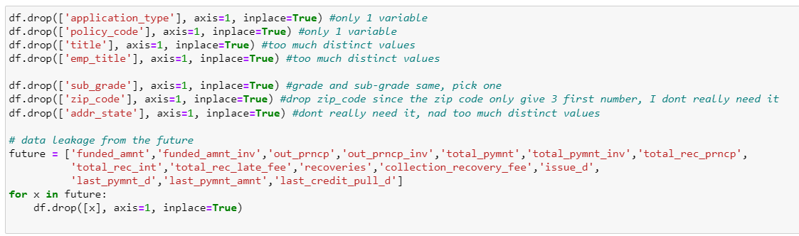
Data Understanding
Drop another columns that don’t really need it the model

Slide 5
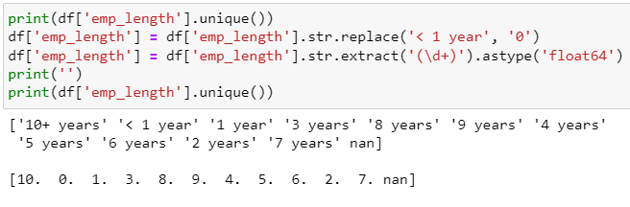
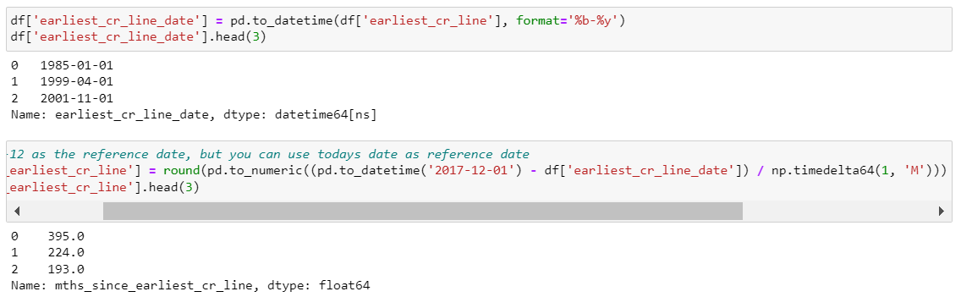
Data Understanding
Change type one of the column that should be ordinal column type
Count months from
earliest date to the
reference date

Slide 6
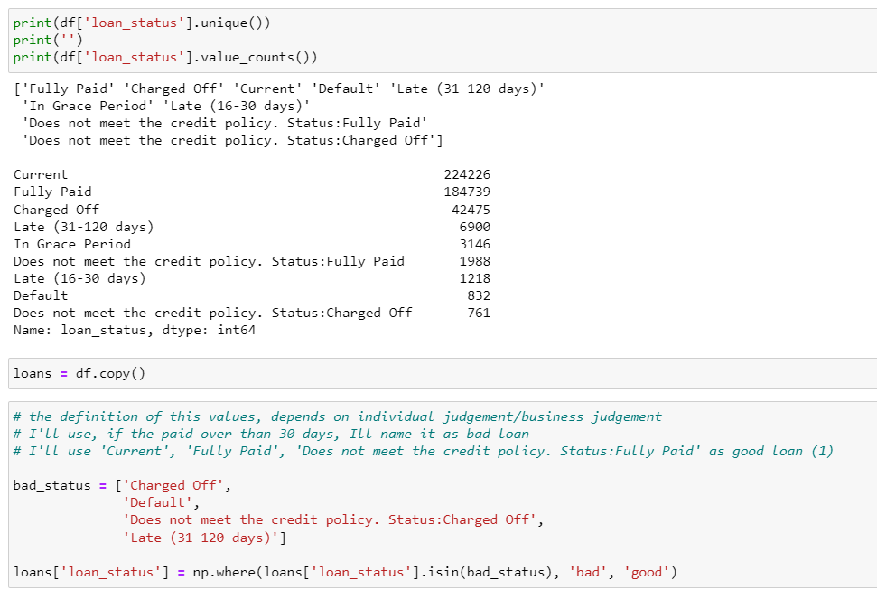
Data Understanding
Set the target variable as “good” and “bad”

Slide 7
EXPLORATORY
DATA ANALYSIS (EDA)

Slide 8
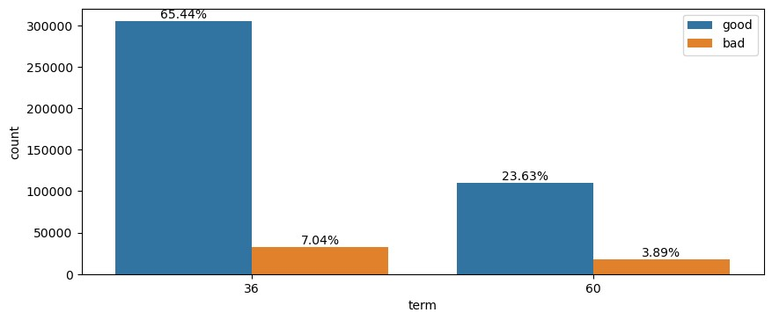
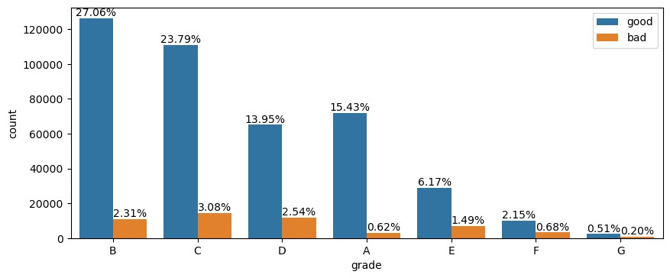
Exploratory Data Analysis (EDA)
Term 36 months is most Fully Paid
and Charged Off
It seems that the higher alphabet, the higher the tendency
to not Full Paid

Slide 9
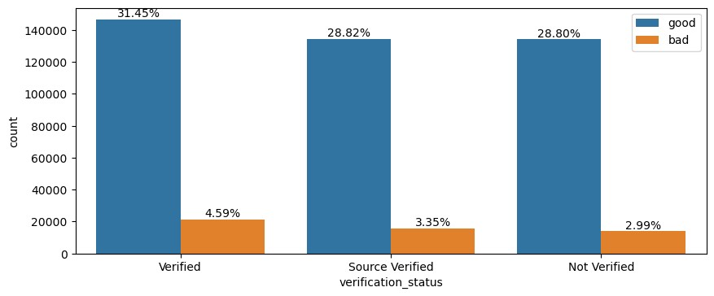
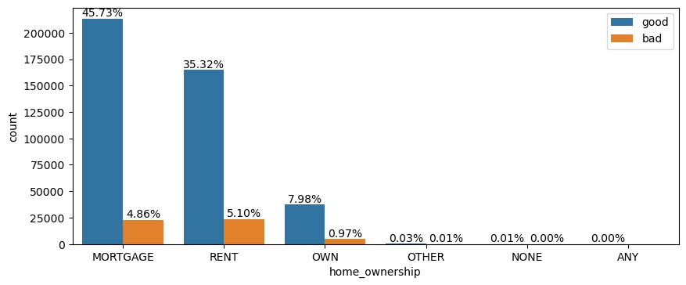
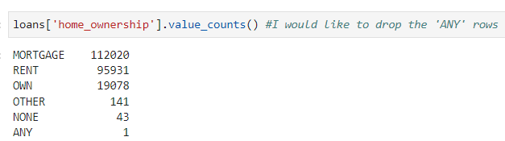
Exploratory Data Analysis (EDA)
The verification status of each values is almost same
each other
Drop ‘ANY’ values

Slide 10
DATA
PREPROCESSING

Slide 11
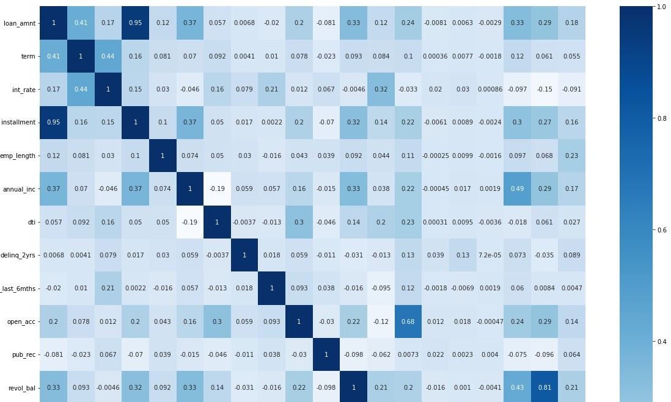
Data Preprocessing
Drop, high correlated
features,
threshold (0.75)
'installment’,
'total_rev_hi_lim'

Slide 12
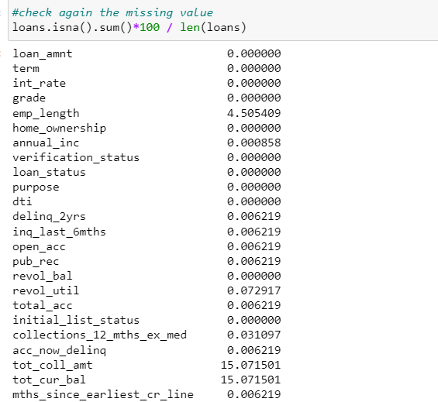
Data Preprocessing
Change loan status values with 0 and 1 (Binary)
Fill NaN values with
median imputation
Change ‘grade’ column into
Ordinal type
Change another object column
into One-Hot-Encoding
‘home_ownership’,
‘verification_status’, ‘purpose’,
‘initial_list_status’)

Slide 13
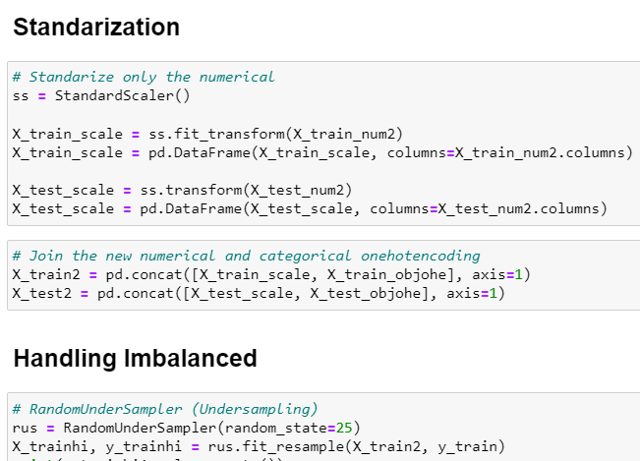
Data Preprocessing

Slide 14
MACHINE LEARNING MODELLING

Slide 15
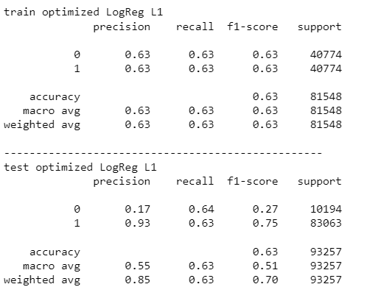
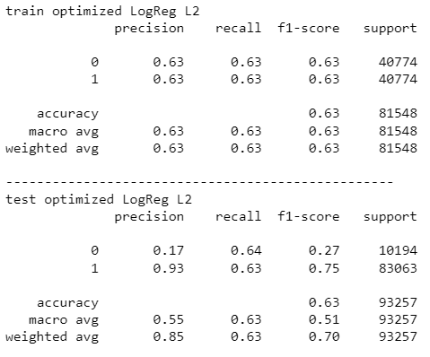
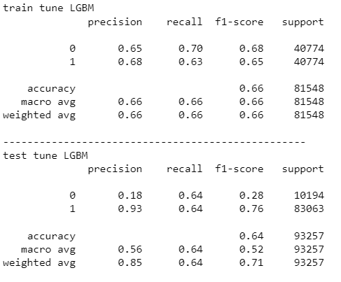
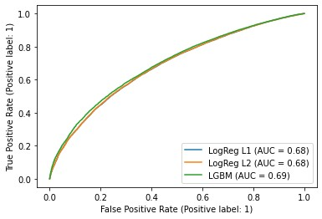
Machine Learning Modelling

